Slide 1
Site Navigation
Tutorial #16

Slide 2
OBJECTIVE

Slide 3
Objective
By the end of this tutorial, you should have a handle on the concept of organizing your web pages and accessory files into a navigable site.

Slide 4
TEXTPLANATION

Slide 5
Textplanation
With all of the attention we pay to coding and design, one of the most important front end pieces that often gets overlooked is site navigation. There’s a big difference between making a web page, like we’ve been doing, and making a website. A website is comprised of several different pages and your end user needs to be able to navigate through those pages with relative ease. User Experience has become an industry all of its own.

Slide 6
Textplanation
The primary method of navigation between pages is through hyperlinks. A hyperlink is simply a string of text that loads an address into the URL. HTML’s anchor tag <a> turns text into a hyperlink. It’s pretty easy to learn, but there are a few nuances to the syntax. You’ll see more of that during the construction.

Slide 7
Textplanation
What I want you to learn is organization. If you have a shopping site, you’re going to have a home page. Wherever the user is on the site, that user needs to be able to get back to the home page. Always. That means that every page that you have has to have a link for that. The home page should have links to all of the upper level pages of your site. All of the upper level pages need to have links to the next level and back so that you’re setting up a navigational hierarchy that is complete and intuitive.

Slide 8
Textplanation
Like programming in Javascript, setting up page navigation requires planning and testing. Know what you’re pages are going to be and what needs to link to them. Run through the site yourself and then have others test it to see if it operates the way you want it to.

Slide 9
CONSTRUCTION

Slide 10
Construction
Create a folder somewhere on your drive and label it Site Navigation.
Open up notepad++.
Save the empty file to your folder and name the file “index.html”.
All first pages on a website are called index.
You will also need a destination.html
As you go through the images of the construction, add to your code. You will see comments with explanations of what you are doing. Those comments will change with each slide. You should not type my comments into your code.

Slide 11
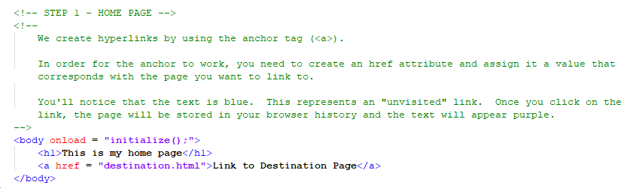
Construction

Slide 12
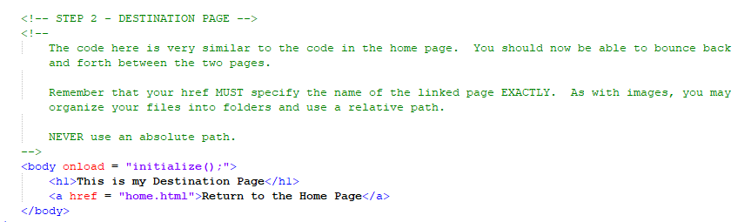
Construction

Slide 13
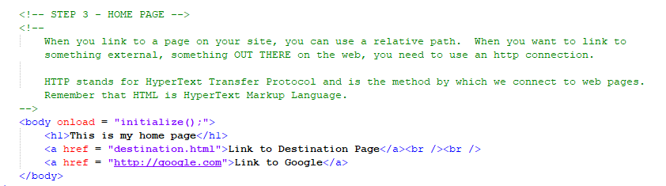
Construction

Slide 14
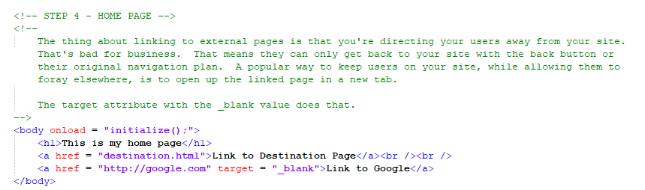
Construction

Slide 15
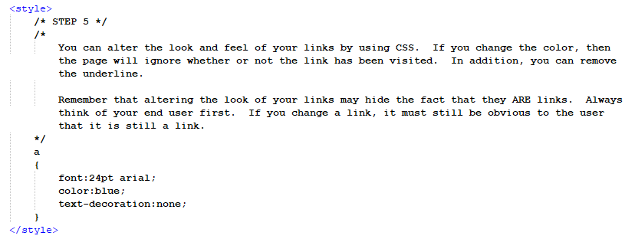
Construction

Slide 16
A DEEPER MEANING

Slide 17
A Deeper Meaning
As internet users, we do most of our navigating by clicks. The number of times we have to actually type an address into the address bar has been dwindling for several years. Even when you first go into your browser, there are usually icons that represent your most visited web pages.

Slide 18
A Deeper Meaning
But did you ever look at a URL? There’s a whole lot more going on in a URL than www.somedumbanimesite.com.

Slide 19
A Deeper Meaning
For example, the “www”. You don’t even need to type that. Sure, it means that you’re looking for a page on the world wide web, but your browser assumes that so you don’t need it. There are other places on the internet though. For example, you might be going to an ftp (or file transfer protocol) server.

Slide 20
A Deeper Meaning
And that’s just the beginning of the URL. There’s stuff at the end of the URL, too. Didn’t you ever notice all of that nonsense after the .com or the .org. Usually, that nonsense starts with a question mark (?). That question mark indicates the beginning of something called the query string. I don’t want to get too deep into this. We can easily create a query string in any of our URLs, but accessing that information isn’t so easy at this stage of the game.

Slide 21
A Deeper Meaning
The query string is made up of property/value pairs (yes, just like CSS, and just like variables - there’s a consistency to computer programming). The query string will look like this:
?property1=value1&property2=value2&...&propertyN=valueN

Slide 22
A Deeper Meaning
Using some serious string manipulation, you can extract the query string and use the data. Yes, the query string is one of the ways that data can be moved from page to page. You can fill it manually by dynamically building a URL in a hyperlink or you can use a form.

Slide 23
A Deeper Meaning
We’re not using forms.

Slide 24
A Deeper Meaning
Not yet.

Slide 25
FAQ

Slide 26
FAQ
Can I dynamically alter the href on an <a>nchor tag?
Absolutely. Remember that every single attribute that belongs to an HTML tag is accessible through the Javascript object. So, if you capture an anchor tag into a Javascript variable (call it myAnchor), you can access the href through the dot (myAnchor.href).
Be really, really, really, really, really, really, really, really, really, really, really careful when creating and changing URLs. If you’re going out to the web, make sure you use the http:// prefix. If you’re accessing one of the pages on your own site, you only need to make sure you use the proper relative path.

Slide 27
ACTIVITY

Slide 28
Categories
Pick something you’re interested in, like movies or music or games or anything at all.
Break it down into categories, sub categories, sub sub categories, and then individual examples.
Create a home page that lists all of the categories.
Each category in the listing should be a link to a page about that category.
On that page should be links to all of the sub categories.
On those pages should be links to the sub sub categories.
Finally, on those last pages should be links to the individual examples. The information for your pages need not be original. If you’re writing a page on a movie or a category of movies, you can grab the text from somewhere else.

Slide 29
Categories
Work with at least 4 links on each page so that it expands out
Create a CSS file that can be used with every page on the site..
Remember that you are setting up a navigational map for your site. Your users needs to be able to move back and forth. Only when you jump to the external site will your users not be able to come back. Most websites handle that by opening the external site in another tab.

